Slide 1

The Organials
Ironhack | Data Analytics | Final Project | Silvia Nicolau

Slide 2

Business
case
CLIENT
Pingo Doce – Product Development
OBJECTIVE
Launch organic products – Costumers?
DATA
Loyalty card – Profiles

Slide 3
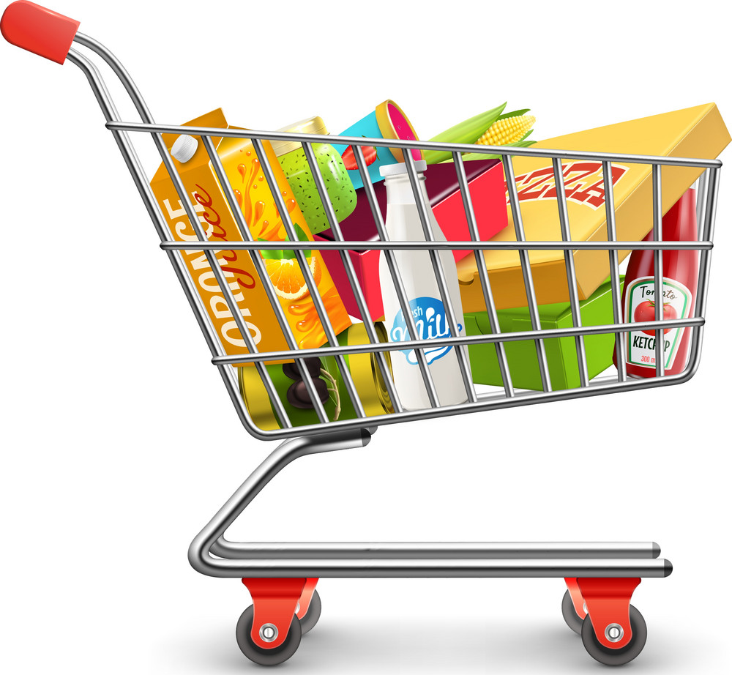
Data
| Kaggle (unknown source)
| UK supermarket loyalty program
| 22.000 observations
Customer features:
Customer Loyalty ID
Gender
Age
Geographic region
Neighbourhood cluster-7 Level
Loyalty card tenure
Loyalty status
Affluence grade
Customer label:
Organics purchase indicator

Slide 4
CLEANING
MACHINE LEARNING
Select features
Remove nulls
Convert categorical
Define evaluation metrics
Test Classification models
Optimize the models
METHODOLOGY
STATISTICS
CASE STUDY
Check distributions
Analyze correlations
Remove collinearity
Gather real data
Apply model
Compare

Slide 5
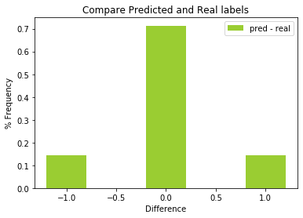
Model
| Decision Tree
Minimize false negatives
Metric | Value
Accuracy | 71,3%
Precision | 51,2%
Recall | 50,8%
F1 | 51,0%
accuracy
false negatives
false positives

Slide 6
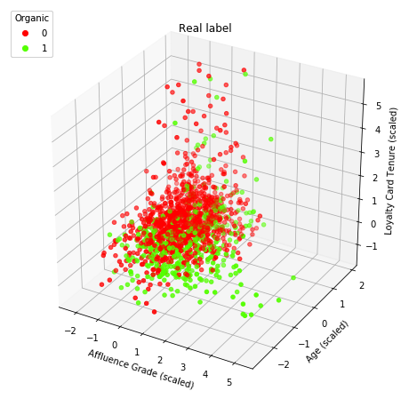
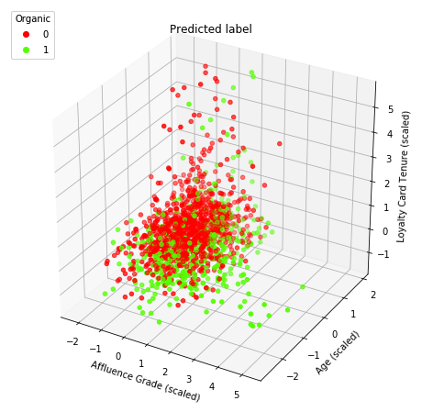
Model
Visually the prediction from the model is very similar to the tested data
Customers with higher affluence, younger age and lower tenure purchase more organic

Slide 7
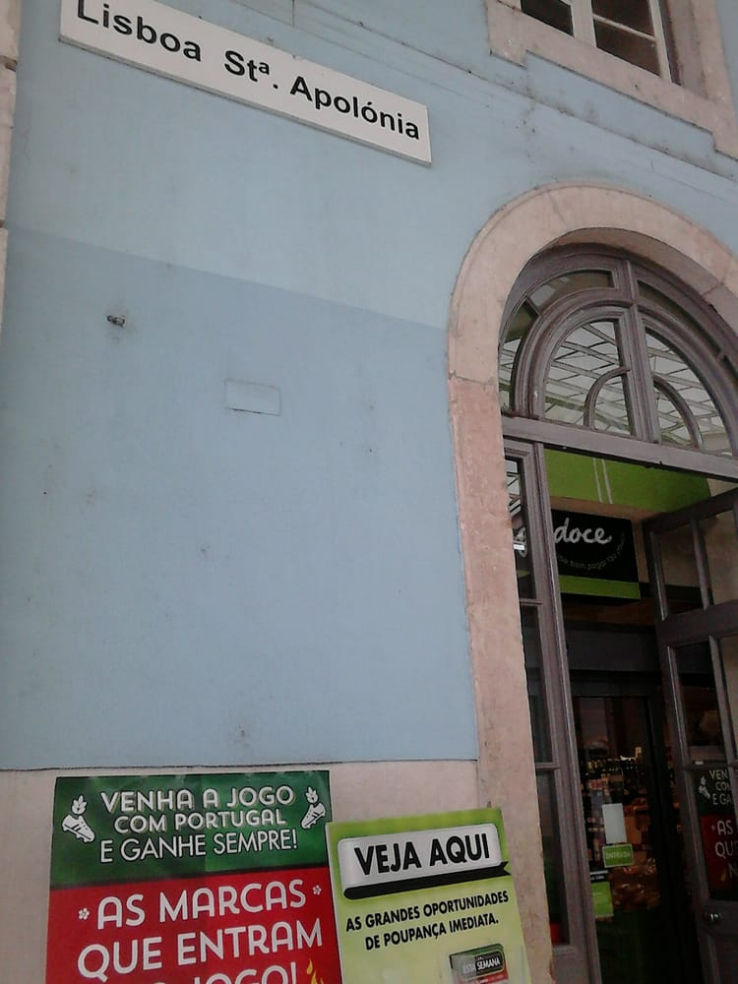
Case Study
| Pingo Doce Santa Apolónia
| Survey with Ironhack students

Slide 8
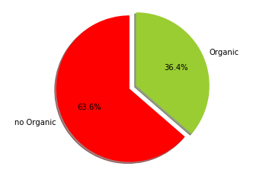
Case Study
| Pingo Doce Santa Apolónia
| Survey with Ironhack students

Slide 9
Name | Organial
Ana Frias | 0
Ana Horta | 0
Beatriz Renault | 0
Carlos Madriz | 0
Cristina Zappullo | 0
Duarte Cruz | 0
Elvira Hanni | 0
Filipe Koch | 0
Gabriela Scatena | 0
João Eira | 1
José Pereira | 1
José Quintas | 0
Maria João Vicente | 0
Marie Hallard | 0
Matheus Cabral | 1
Mattia Lobascio | 0
Ricardo Zacarias | 1
Rute Correia | 1
Silvia Nicolau | 1
Tiago Dias | 1
Tiago Paim | 1
Tristan Piat | 0
Case Study
| Pingo Doce Santa Apolónia
| Survey with Ironhack students

Slide 10
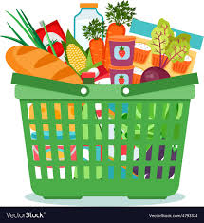
Final
Recommendation
CUSTOMERS
Younger, frequent, not engaged to the card
PRODUCTS
Biscuits and Soups
TIMING
When courses start and after quarantines

Slide 11
Thank You!
Ironhack | Data Analytics | Final Project | Silvia Nicolau

